Slide 1

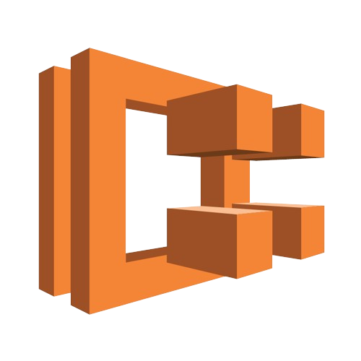
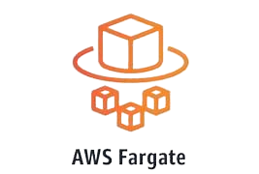
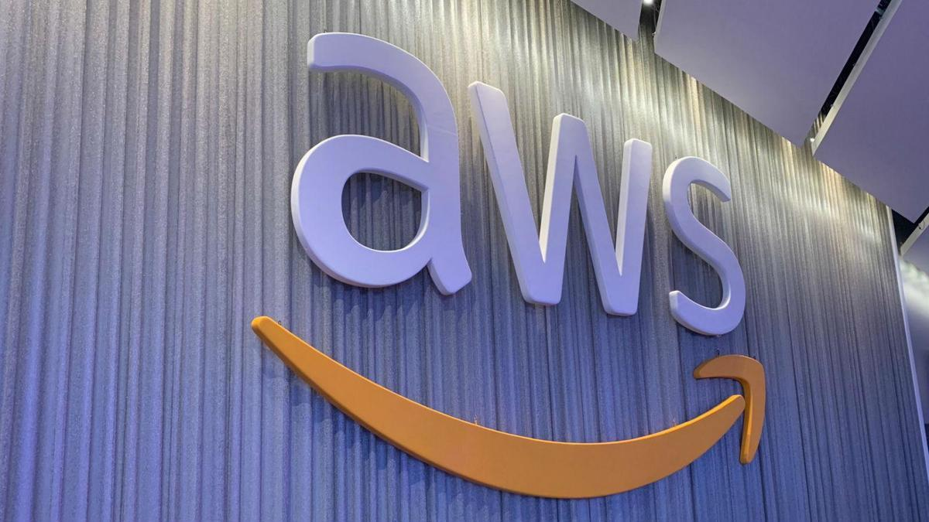



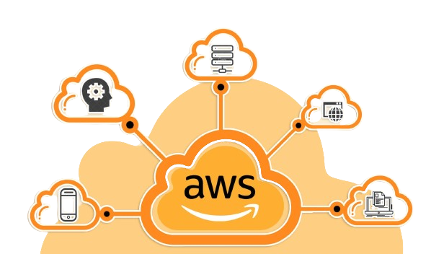
What is an Compute??
Compute refers to the processing power needed to run applications, execute tasks, and handle workloads.
Types of Compute
Virtual Machines (VMs): Like Amazon EC2 instances, provide customizable compute capacity.
Serverless Compute: Like AWS Lambda, automatically manages the compute resources required for code execution.
Containerized Compute: Like Amazon ECS and AWS Fargate, provides scalable and efficient compute for containerized applications.
Team No 1
Topic : AWS Compute server
Agenda :
Compute
EC2 Instance Types:
AWS Lambda:
Amazon ECS
Elastic Beanstalk
Comparison of AWS Compute Services
Best Practices and Security Considerations
Case Studies
By…
N Lokesh
Trainer : Mr. Lavish Arora
Introduction to AWS Compute Services
AWS offers a suite of compute services that cater to a wide range of applications and workloads. These services enable developers to provision and manage computing resources in the cloud with ease.

Slide 2
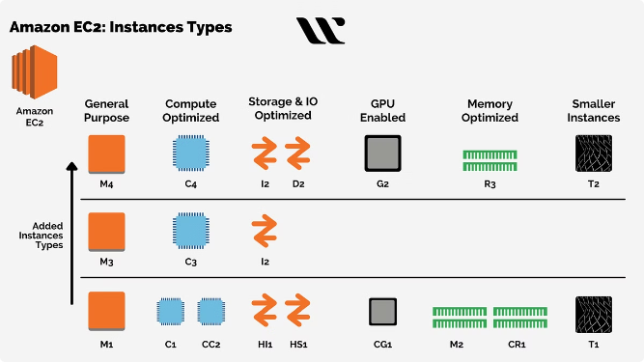
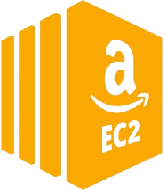
Topic : AWS Compute server’s
Agenda :
Amazon EC2
EC2 Instance Types:
AWS Lambda:
Amazon ECS
AWS Fargate
Elastic Beanstalk
Comparison of AWS Compute Services
Best Practices and Security Considerations
Case Studies:
Introduction to AWS Compute Services
AWS offers a suite of compute services that cater to a wide range of applications and workloads. These services enable developers to provision and manage computing resources in the cloud with ease.
Virtual Private Cloud (Subnet, internet Getaway, Routes, (NAT) Gateway3 Security group,
Topic : AWS Compute server
Agenda :
Compute
EC2 Instance Types:
AWS Lambda:
Amazon ECS
Elastic Beanstalk
Comparison of AWS Compute Services
Best Practices and Security Considerations
Case Studies
By…
Nelluri Lokesh
21A31A0552
CSE - A

Slide 3
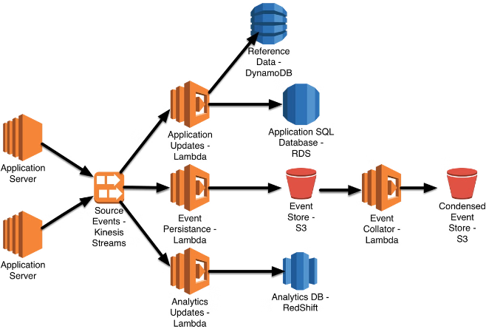
AWS Lambda is a serverless computing service that runs code in response to events and automatically manages the underlying compute resources.
Integration with AWS Services:
1. Security: AWS Lambda integrates with IAM (Identity and Access Management) for fine-grained access control.
2. Networking: Functions can be configured to access resources inside a VPC (Virtual Private Cloud) for secure communication with other AWS services or on- premises resources.
AWS Lambda
EC2 server’s :
1.. Amazon EC2 offers resizable compute capacity in the
cloud, allowing users to quickly scale capacity up or down.
2. Users can launch virtual servers (instances) based on their computing needs.
It costs $0.0104 per hour and $7 per month
Uses Cases :
Hosting applications and websites
Big data analytics
Machine learning
Gaming Applications

Slide 4
Run Docker Containers: using dockers we can isolate our resources from other resources
2. Manage Container Clusters: by using this it helps you to manage you tasks like running, stopping
3. Integration with AWS Services: ECS works smoothly with other AWS services such as load balancers and IAM
AWS Lambda
AWS Lambda is a serverless computing service that runs code in response to events and automatically manages the underlying compute resources.
Integration with AWS Services:
1. Security: AWS Lambda integrates with IAM (Identity and Access Management) for fine-grained access control.
2. Networking: Functions can be configured to access resources inside a VPC (Virtual Private Cloud) for secure communication with other AWS services or on-premises resources.
EC2 server’s :
1.. Amazon EC2 offers resizable compute capacity in the
cloud, allowing users to quickly scale capacity up or down.
2. Users can launch virtual servers (instances) based on their computing needs.
It costs $0.0104 per hour and $7 per month
Uses Cases :
Hosting applications and websites
Big data analytics
Machine learning
Gaming Applications

Slide 5
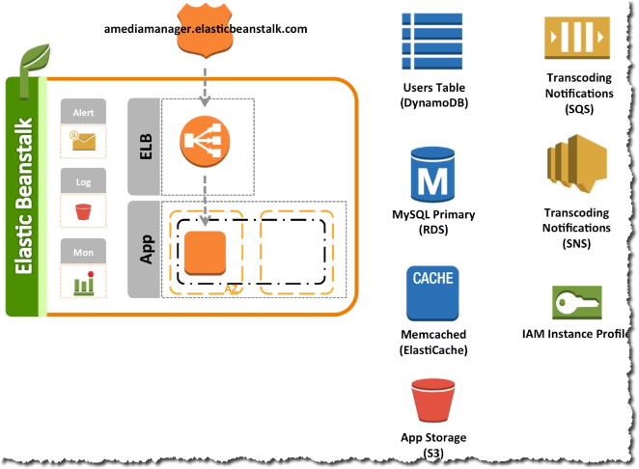



4. Automatic Scaling: Auto scaling automatically adjusts the number of compute resources based on demand to maintain performance and optimize costs.
5 Task Definitions: ECS uses task definitions to specify how containers should be run, including Docker image, CPU, memory requirements, and networking configuration.
6. Deployment Options: It supports different deployment strategies like rolling updates, allowing you to update your application without downtime.
AWS Lambda
Elastic Beanstalk
Simplified Deployment
Automatic Scaling
Amazon ECS (Elastic Container Service)
Elastic Beanstalk is a fully managed platform-as-a-service that simplifies the deployment and management of web applications and services. It takes care of the underlying infrastructure and configurations.
Beanstalk automatically scales your applications based on demand, ensuring that they can handle fluctuations in traffic and maintain performance.
Run Docker Containers: using dockers we can isolate our resources from other resources
2. Manage Container Clusters: by using this it helps you to manage you tasks like running, stopping
3. Integration with AWS Services: ECS works smoothly with other AWS services such as load balancers and IAM
Centralized Management
Support for Multiple Technologies
Beanstalk provides a unified dashboard for monitoring, logging, and managing your applications, making it easy to track their health and performance.
Elastic Beanstalk supports a variety of programming languages, frameworks, and platforms, making it a versatile platform for deploying various types of applications.
AWS Lambda is a serverless computing service that runs code in response to events and automatically manages the underlying compute resources.
Integration with AWS Services:
1. Security: AWS Lambda integrates with IAM (Identity and Access Management) for fine-grained access control.
2. Networking: Functions can be configured to access resources inside a VPC (Virtual Private Cloud) for secure communication with other AWS services or on-premises resources.
EC2 server’s :
1.. Amazon EC2 offers resizable compute capacity in the
cloud, allowing users to quickly scale capacity up or down.
2. Users can launch virtual servers (instances) based on their computing needs.
It costs $0.0104 per hour and $7 per month
Uses Cases :
Hosting applications and websites
Big data analytics
Machine learning
Gaming Applications

Slide 6
AWS Lambda
Run Docker Containers: using dockers we can isolate our resources from other resources
2. Manage Container Clusters: by using this it helps you to manage you tasks like running, stopping
3. Integration with AWS Services: ECS works smoothly with other AWS services such as load balancers and IAM
Elastic Beanstalk
Amazon ECS (Elastic Container Service)
Simplified Deployment
Automatic Scaling
Elastic Beanstalk is a fully managed platform-as-a-service that simplifies the deployment and management of web applications and services. It takes care of the underlying infrastructure and configurations.
Beanstalk automatically scales your applications based on demand, ensuring that they can handle fluctuations in traffic and maintain performance.
4. Automatic Scaling: Auto scaling automatically adjusts the number of compute resources based on demand to maintain performance and optimize costs.
5 Task Definitions: ECS uses task definitions to specify how containers should be run, including Docker image, CPU, memory requirements, and networking configuration.
6. Deployment Options: It supports different deployment strategies like rolling updates, allowing you to update your application without downtime.
Centralized Management
Support for Multiple Technologies
Beanstalk provides a unified dashboard for monitoring, logging, and managing your applications, making it easy to track their health and performance.
Elastic Beanstalk supports a variety of programming languages, frameworks, and platforms, making it a versatile platform for deploying various types of applications.
AWS Lambda is a serverless computing service that runs code in response to events and automatically manages the underlying compute resources.
Integration with AWS Services:
1. Security: AWS Lambda integrates with IAM (Identity and Access Management) for fine-grained access control.
2. Networking: Functions can be configured to access resources inside a VPC (Virtual Private Cloud) for secure communication with other AWS services or on-premises resources.
EC2 server’s :
1.. Amazon EC2 offers resizable compute capacity in the
cloud, allowing users to quickly scale capacity up or down.
2. Users can launch virtual servers (instances) based on their computing needs.
It costs $0.0104 per hour and $7 per month
Uses Cases :
Hosting applications and websites
Big data analytics
Machine learning
Gaming Applications

Slide 7

4. Automatic Scaling: You can set up ECS to automatically scale your application based on traffic or resource usage, ensuring your application runs smoothly under varying loads.
5 Task Definitions: ECS uses task definitions to specify how containers should be run, including Docker image, CPU, memory requirements, and networking configuration.
6. Deployment Options: It supports different deployment strategies like rolling updates, allowing you to update your application without downtime.
AWS Lambda
Elastic Beanstalk
Simplified Deployment
Automatic Scaling
Comparison of AWS Compute Services
Elastic Beanstalk is a fully managed platform-as-a-service that simplifies the deployment and management of web applications and services. It takes care of the underlying infrastructure and configurations.
Beanstalk automatically scales your applications based on demand, ensuring that they can handle fluctuations in traffic and maintain performance.
Centralized Management
Support for Multiple Technologies
Beanstalk provides a unified dashboard for monitoring, logging, and managing your applications, making it easy to track their health and performance.
Elastic Beanstalk supports a variety of programming languages, frameworks, and platforms, making it a versatile platform for deploying various types of applications.
AWS provides various compute services to fit your needs. EC2, Lambda, and ECS offer different benefits in terms of performance, cost, and scalability. Understanding these differences is crucial for selecting the best service for your specific application.
EC2 server’s :
1.. Amazon EC2 offers resizable compute capacity in the
cloud, allowing users to quickly scale capacity up or down.
2. Users can launch virtual servers (instances) based on their computing needs.
It costs $0.0104 per hour and $7 per month
Uses Cases :
Hosting applications and websites
Big data analytics
Machine learning
Gaming Applications

Slide 8
Amazon ECS (Elastic Container Service)
Fully managed container orchestration service for Docker containers on AWS
Simplifies deployment, management, and scaling of containerized applications.
Key Features:
Managed Service: AWS handles infrastructure, scaling, and availability.
Integration: Works seamlessly with AWS services like IAM, VPC, and CloudWatch.
Scalability: Supports both Fargate (serverless) and EC2 launch types.
Flexibility: Easy deployment and management with AWS tools like CloudFormation.
AWS Lambda
Comparison of AWS Compute Services
Best Practices and Security Considerations
Security Groups
IAM Roles
Encryption
Restrict inbound and outbound traffic based on IP addresses, ports, and protocols. Configure security groups to control access to your instances.
Assign specific permissions to users and instances for access control. Avoid using root credentials and follow the principle of least privilege.
Encrypt data at rest and in transit using AWS Key Management Service (KMS) and TLS/SSL protocols for secure communication.
AWS provides various compute services to fit your needs. EC2, Lambda, and ECS offer different benefits in terms of performance, cost, and scalability. Understanding these differences is crucial for selecting the best service for your specific application.
Elastic Beanstalk
Simplified Deployment
Automatic Scaling
Elastic Beanstalk is a fully managed platform-as-a-service that simplifies the deployment and management of web applications and services. It takes care of the underlying infrastructure and configurations.
Beanstalk automatically scales your applications based on demand, ensuring that they can handle fluctuations in traffic and maintain performance.
Centralized Management
Support for Multiple Technologies
Beanstalk provides a unified dashboard for monitoring, logging, and managing your applications, making it easy to track their health and performance.
Elastic Beanstalk supports a variety of programming languages, frameworks, and platforms, making it a versatile platform for deploying various types of applications.
EC2 server’s :
1.. Amazon EC2 offers resizable compute capacity in the
cloud, allowing users to quickly scale capacity up or down.
2. Users can launch virtual servers (instances) based on their computing needs.
It costs $0.0104 per hour and $7 per month
Uses Cases :
Hosting applications and websites
Big data analytics
Machine learning
Gaming Applications

Slide 9
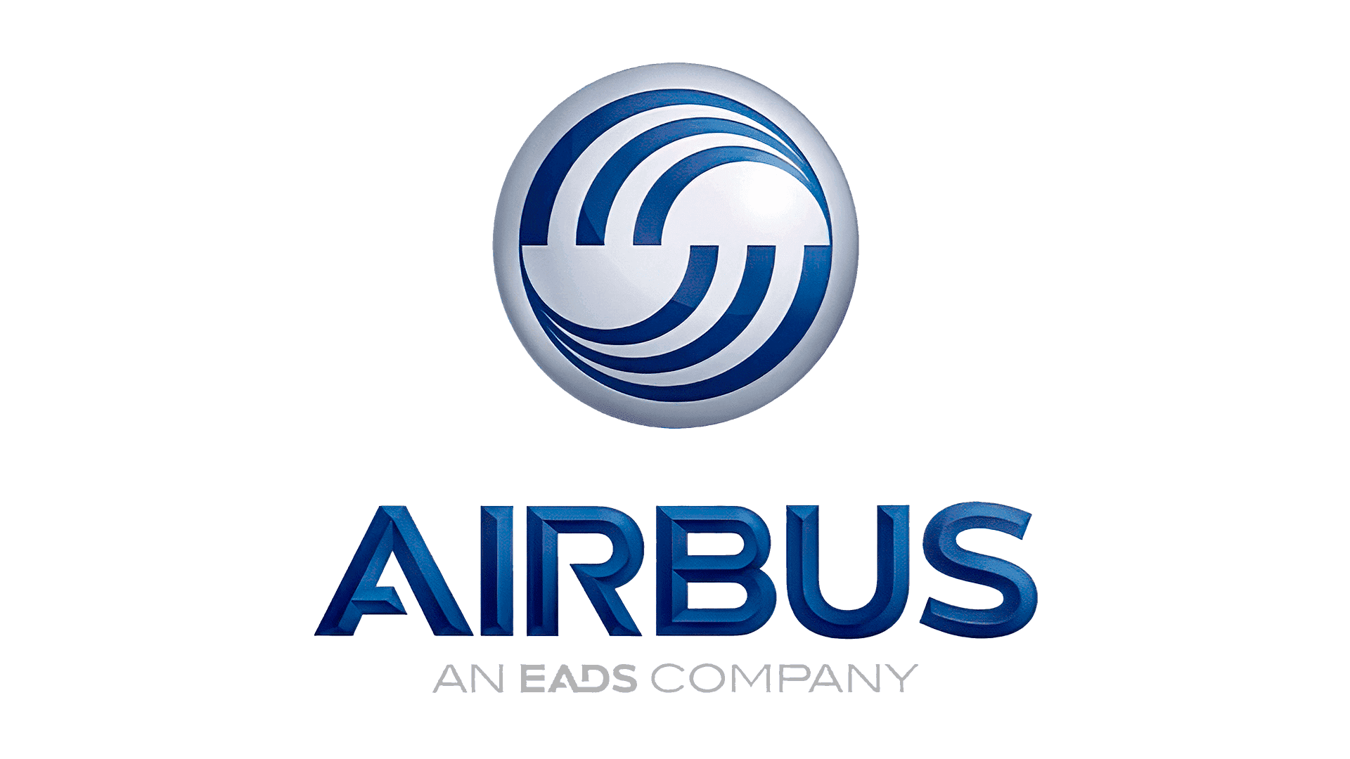

AWS Lambda
Best Practices and Security Considerations
Comparison of AWS Compute Services
Security Groups
IAM Roles
Encryption
Restrict inbound and outbound traffic based on IP addresses, ports, and protocols. Configure security groups to control access to your instances.
Assign specific permissions to users and instances for access control. Avoid using root credentials and follow the principle of least privilege.
Encrypt data at rest and in transit using AWS Key Management Service (KMS) and TLS/SSL protocols for secure communication.
Case Studies and Future Trends
Airbus (EC2):
Usage:
Airbnb utilizes EC2 instances for maintaining flexibility and exerting control over their infrastructure.
Benefits:
They benefit from customizable configurations that cater to their diverse application needs, ensuring they can tailor their environment precisely to their operational requirements.
Netflix (Lambda):
Usage:
Netflix employs AWS Lambda extensively for executing event-driven tasks and supporting their microservices architecture.
Benefits:
Lambda provides scalability that aligns with variable demand patterns, ensures cost-effectiveness by charging only for compute time used, and reduces operational overhead by managing the infrastructure automatically, allowing Netflix to focus more on application logic and less on server management.

Slide 10
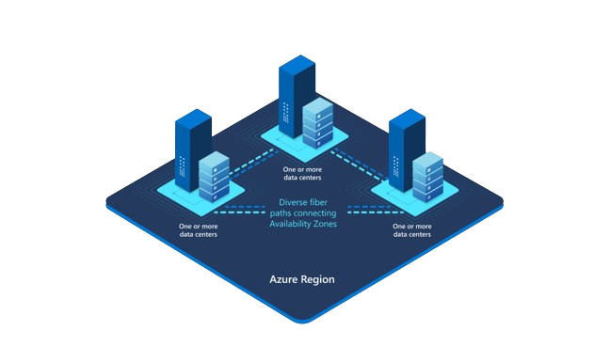

Best Practices and Security Considerations
AWS Lambda
Case Studies and Future Trends
Airbus (EC2):
Usage:
Airbus utilizes EC2 instances for maintaining flexibility and exerting control over their infrastructure.
Benefits:
They benefit from customizable configurations that cater to their diverse application needs, ensuring they can tailor their environment precisely to their operational requirements.
Netflix (Lambda):
Usage:
Netflix employs AWS Lambda extensively for executing event-driven tasks and supporting their microservices architecture.
Benefits:
Lambda provides scalability that aligns with variable demand
patterns, ensures cost-effectiveness by charging only for compute time used, and reduces operational overhead by managing the infrastructure automatically, allowing Netflix to focus more on application logic
and less on server management.
Comparison of AWS Compute Services
Encryption
IAM Roles
Security Groups
Encrypt data at rest and in transit using AWS Key Management Service (KMS) and TLS/SSL protocols for secure communication.
Assign specific permissions to users and instances for access control. Avoid using root credentials and follow the principle of least privilege.
Restrict inbound and outbound traffic based on IP addresses, ports, and protocols. Configure security groups to control access to your instances.
Title: Hosting Applications and Websites for a Service-Based Business
Availability Zone 2
This case study explores the challenges of hosting applications and websites for a service-based business with two branches in different locations. This presentation will highlight the complexities and potential solutions for ensuring seamless operation and data synchronization across multiple sites.
Availability Zone 1
Availability Zone 3

Slide 11
Best Practices and Security Considerations
U
A
N
AWS Lambda
Case Studies and Future Trends
Title: Hosting Applications and Websites for a Service-Based Business
Comparison of AWS Compute Services
Availability Zone 2
This case study explores the challenges of hosting applications and websites for a service-based business with two branches in different locations. This presentation will highlight the complexities and potential solutions for ensuring seamless operation and data synchronization across multiple sites.
Availability Zone 1
Availability Zone 3
T
Encryption
IAM Roles
Security Groups
Encrypt data at rest and in transit using AWS Key Management Service (KMS) and TLS/SSL protocols for secure communication.
Assign specific permissions to users and instances for access control. Avoid using root credentials and follow the principle of least privilege.
Restrict inbound and outbound traffic based on IP addresses, ports, and protocols. Configure security groups to control access to your instances.
H
Y
Airbus (EC2):
Usage:
Airbnb utilizes EC2 instances for maintaining flexibility and exerting control over their infrastructure.
Benefits:
They benefit from customizable configurations that cater to their diverse application needs, ensuring they can tailor their environment precisely to their operational requirements.
Netflix (Lambda):
Usage:
Netflix employs AWS Lambda extensively for executing event-driven tasks and supporting their microservices architecture.
Benefits:
Lambda provides scalability that aligns with variable demand
patterns, ensures cost-effectiveness by charging only for compute time used, and reduces operational overhead by managing the infrastructure automatically, allowing Netflix to focus more on application logic
and less on server management.
K
O

Slide 12
Best Practices and Security Considerations
AWS Lambda
Case Studies and Future Trends
Availability Zone 2
Comparison of AWS Compute Services
Availability Zone 1
Availability Zone 3
T
H
A
N
K
Encryption
IAM Roles
Security Groups
Y
O
U
Encrypt data at rest and in transit using AWS Key Management Service (KMS) and TLS/SSL protocols for secure communication.
Assign specific permissions to users and instances for access control. Avoid using root credentials and follow the principle of least privilege.
Restrict inbound and outbound traffic based on IP addresses, ports, and protocols. Configure security groups to control access to your instances.
Title: Hosting Applications and Websites for a Service-Based Business
This case study explores the challenges of hosting applications and websites for a service-based business with two branches in different locations. This presentation will highlight the complexities and potential solutions for ensuring seamless operation and data synchronization across multiple sites.
Airbus (EC2):
Usage:
Airbnb utilizes EC2 instances for maintaining flexibility and exerting control over their infrastructure.
Benefits:
They benefit from customizable configurations that cater to their diverse application needs, ensuring they can tailor their environment precisely to their operational requirements.
Netflix (Lambda):
Usage:
Netflix employs AWS Lambda extensively for executing event-driven tasks and supporting their microservices architecture.
Benefits:
Lambda provides scalability that aligns with variable demand
patterns, ensures cost-effectiveness by charging only for compute time used, and reduces operational overhead by managing the infrastructure automatically, allowing Netflix to focus more on application logic
and less on server management.

